Slide 1
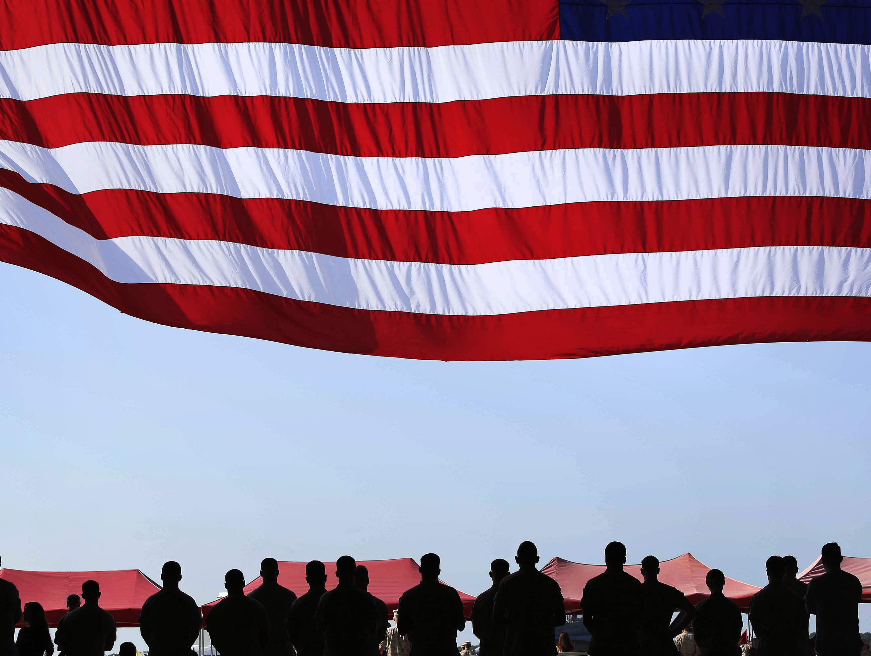
National Survey
March 8-11, 2021
N= 1,200 Likely Voters

Slide 2

Methodology
  National survey conducted on
  March 8-11, 2021.
  1200 likely general election voters and was stratified to reflect historic voter trends.
  Margin of error for this survey is +/- 2.82%.

Slide 3
Election Reforms
Thinking about election reforms, which of the following goals do you think is most important?
Ensuring that all elections are fair and free of voter fraud.
Increasing voter participation by making it as easy as possible for people to vote.
39%
23%
36%

Slide 4
Election Reforms
Free & Fair
Increase Participation
DK/Refused
Location
Suburban Gender
26%
71%
16%
15%
Age
Race
25%
75%
71%
11%
11%

Slide 5
Consider Election Reforms
Please tell me if you agree or disagree with the following statement. Given the number of questions about potential voter fraud concerning the 2020 election, it’s time to consider election reforms that will protect the process and give us more confidence in the results.
66
Strongly Agree
Somewhat Agree
Somewhat Disagree
Strongly Disagree
DK/Refused
28
39%
23%
36%

Slide 6
Elections Funded by Tax Dollars
Currently all federal elections, which are campaigns for president, senate and congress, are almost entirely funded by donations, and are subject to a number of regulations regarding who can donate and how much they can give. One bill being debated in Congress right now would make all federal elections funded by tax dollars instead of donations. Do you favor or oppose using tax dollars to pay for federal elections?
56
Strongly Favor
Somewhat Favor
Somewhat Oppose
Strongly Oppose
DK/Refused
31
39%
23%
36%

Slide 7
Concern Series – Same Day Registration
Allowing voters to register to vote at the polling place, on election day, without any form of photo ID.
81
Very Concerned
Somewhat Concerned
No Very Concerned
Not at all Concernec
DK/Refused
17
39%
23%
36%

Slide 8
Concern Series – Voter ID
Not requiring a photo ID or any other identification for those requesting an absentee ballot.
72
Very Concerned
Somewhat Concerned
No Very Concerned
Not at all Concernec
DK/Refused
25
39%
23%
36%

Slide 9
Voter ID
Now I am going to read you two statements about requiring people to show an ID in order to vote. Please tell me which of the following you most agree with.
Some people say that in America today you have to show ID for common activities like flying, banking, renting a car, entering many government buildings, and purchasing alcohol and tobacco. Given this, they say we should also require an ID to vote in order to prevent voter fraud.
Other people say that requiring an ID to vote prevents many minority and low-income people from voting. They say that those pushing for voter ID laws are only trying to disenfranchise voters to give their party an advantage.
39%
23%
36%

Slide 10
Concern Series – Ballot Harvesting
Allowing political organizations and activists to collect thousands of ballots and deliver them unsupervised to the county clerk, opening up the chance that ballots could be destroyed or changed before they are submitted.
83
Very Concerned
Somewhat Concerned
No Very Concerned
Not at all Concernec
DK/Refused
16
39%
23%
36%

Slide 11
Concern Series – Voter File Cleaning
Not requiring states to regularly clean up their voter registration file to ensure that people who have died or moved out of state are removed from the file.
82
Very Concerned
Somewhat Concerned
No Very Concerned
Not at all Concernec
DK/Refused
17
39%
23%
36%

Slide 12
Concern Series – Remote Ballot Drop Boxes
Allowing remote ballot drop boxes with no security that can lead to potential ballot tampering or a single person voting multiple times.
74
Very Concerned
Somewhat Concerned
No Very Concerned
Not at all Concernec
DK/Refused
24
39%
23%
36%

Slide 13
Concern Series – Universal Mail-in Voting
Mailing ballots to everyone who is registered to vote even if they didn’t request it, allowing thousands of ballots to be sent to the wrong address or to be stolen from mailboxes of those unaware that they were getting a mail ballot.
71
Very Concerned
Somewhat Concerned
No Very Concerned
Not at all Concernec
DK/Refused
26
39%
23%
36%

Slide 14
Solution Series – Only US Citizens Vote
90
Only allowing U.S. citizens to vote.
Strongly Favor
Somewhat Favor
Somewhat Oppose
Strongly Oppose
DK/Refused
8
39%
23%
36%

Slide 15
Solution Series – Cleaning Voter File
Requiring states to clean up their voter registration file every two years in order to remove those who have died or moved out of the state.
89
Strongly Favor
Somewhat Favor
Somewhat Oppose
Strongly Oppose
DK/Refused
8
39%
23%
36%

Slide 16
Solution Series – More Polling Locations
Increasing the number of polling locations and voting machines to reduce wait times on election day so that there is less reason for people to vote by mail.
88
Strongly Favor
Somewhat Favor
Somewhat Oppose
Strongly Oppose
DK/Refused
8
39%
23%
36%

Slide 17
Solution Series – Received by Election Day
Requiring ballots to be received or postmarked on or before election day in order to be counted.
83
Strongly Favor
Somewhat Favor
Somewhat Oppose
Strongly Oppose
DK/Refused
16
39%
23%
36%

Slide 18
Solution Series – Monitored Drop Boxes
Requiring all ballot drop boxes to be inside of election offices or other government buildings, so they can be monitored at all times.
78
Strongly Favor
Somewhat Favor
Somewhat Oppose
Strongly Oppose
DK/Refused
20
39%
23%
36%

Slide 19
Solution Series – Require Voter ID
Requiring voters to present a valid photo ID in order to stop people from fraudulently voting for others.
77
Strongly Favor
Somewhat Favor
Somewhat Oppose
Strongly Oppose
DK/Refused
17
39%
23%
36%

Slide 20
Reporting Ballots Cast
As you may know, some states have laws that require all precincts to report the total number of ballots cast within three hours of the polls closing. That’s not counting the ballots, it’s just reporting the total number of ballots cast. This helps ensure that additional ballots don’t show up after election day. Do you favor or oppose these laws?
69
Strongly Favor
Somewhat Favor
Somewhat Oppose
Strongly Oppose
DK/Refused
22
39%
23%
36%

Slide 21
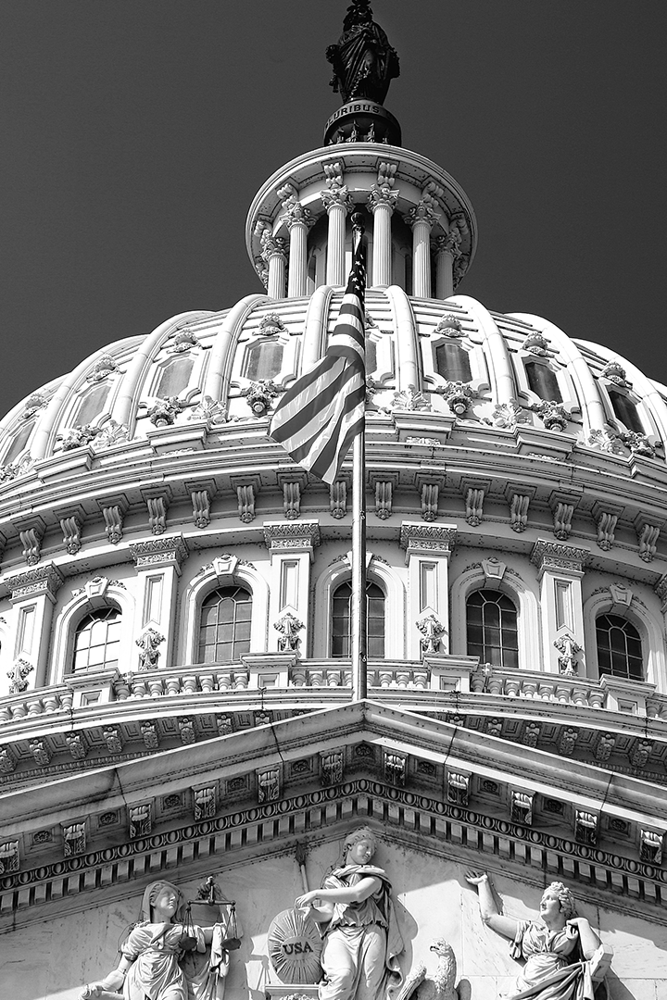

National Survey
March 8-11, 2021
N= 1,200 Likely Voters

